Slide 1
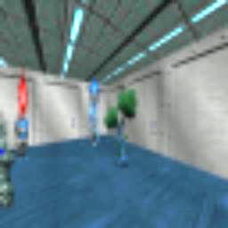
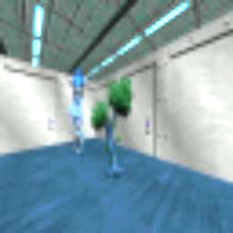
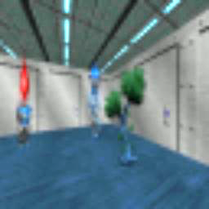
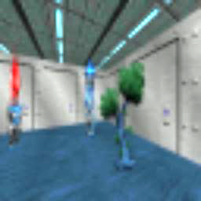
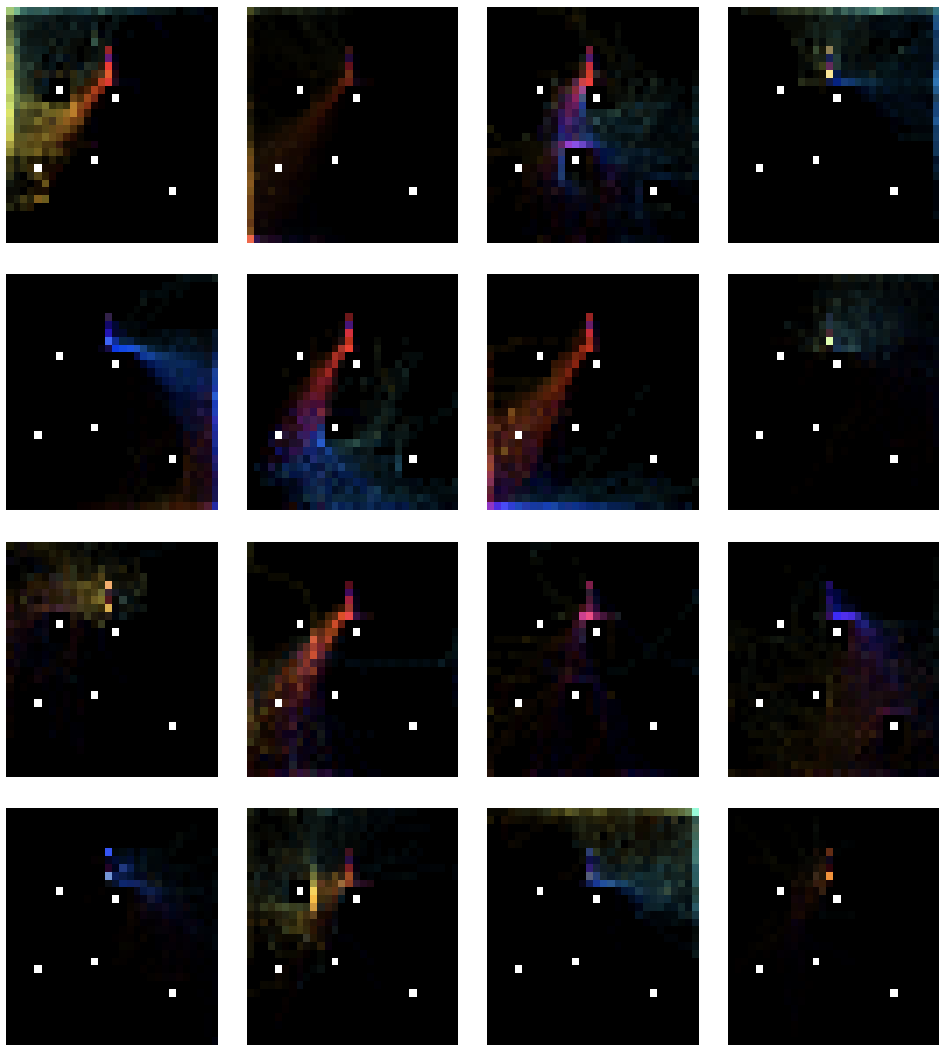
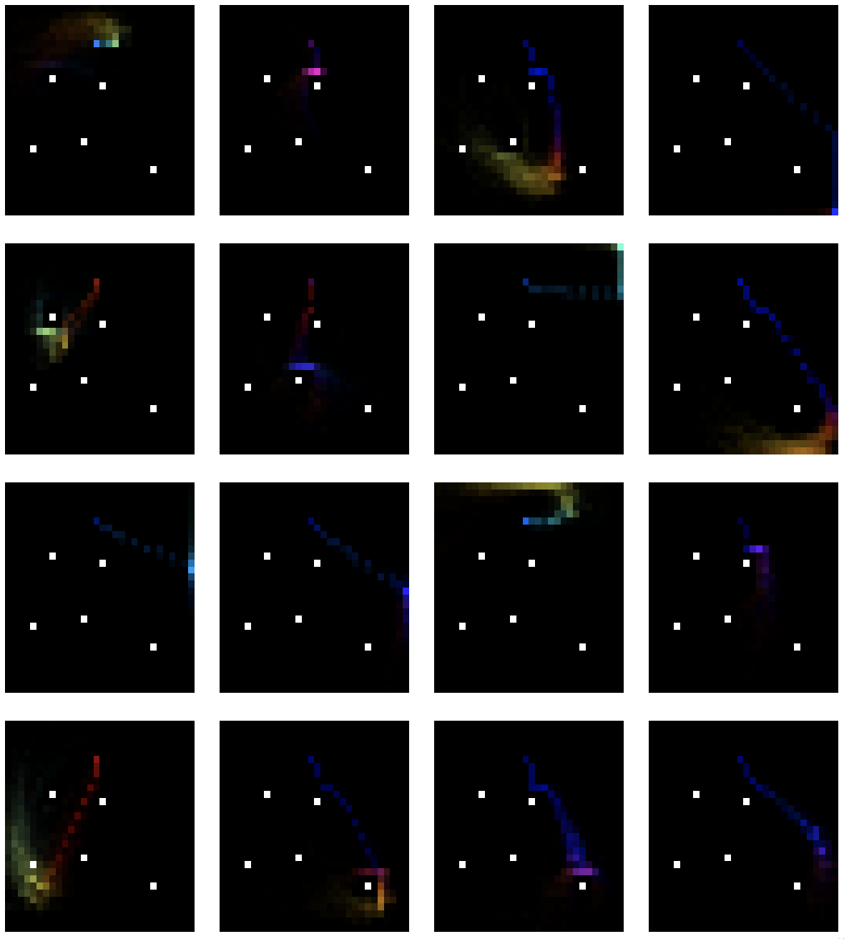
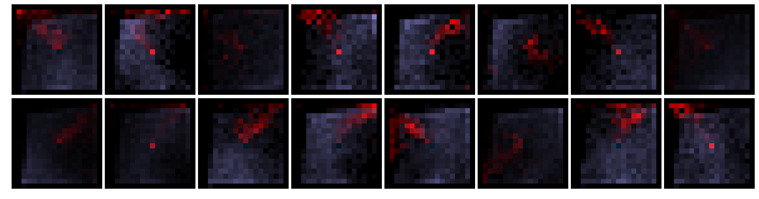
Unsupervised Curricula for Visual Meta-Reinforcement Learning Allan Jabri, Kyle Hsu, Ben Eysenbach, Abhishek Gupta, Sergey Levine, Chelsea Finn
Motivation
Method
Experiments
Meta-RL provides a framework for transfer between policies for different tasks, but relies on specification of a task distribution
Main Idea: Jointly discover and meta-learn tasks by alternating between task acquisition and meta-reinforcement learning of updated task distribution.
Do acquired meta-RL strategies transfer to test task distributions?
Direct Transfer: Apply policy to tesk tasks without finetuning
Finetuning: Update parameters of policy to specific test tasks
Can useful meta-RL strategies be acquired by pretraining with task distribution formed through unsupervised interaction?
Data
E-step
+
M-step
Organize
Meta-Train
Faster
Finetuning
Update task scaffold
+
+
Update policy
Direct
Transfer
Tasks
VizDoom
Sawyer
Trajectory-level discriminative clustering
Policy learns updated task distribution
Comparing Variants: Task Acquisition and Joint Optimization
Online disc.: Discriminative
Avoiding mode collapse in task distribution
Key Challenges
i.e. learn tasks
Pipelined CARML: 1 E-step, 1 M-step
Conditional Independence
Task acquisition with high-dimensional observations, i.e. pixels.
Adaptation of task distribution and meta-learner, i.e. curriculum.
Formulation
Environments and Discovered Tasks
Visualization of Discovered Task Distributions
Ours
DIAYN
Intuition: Prepare meta-RL agent with task inference and execution strategies that transfer
Information Maximization
Meta-Pretraining: Accelerated Supervised Meta-RL
Allows for accelerated supervised learning of test task distributions
even when considering pretrained encoder
Task dist. should balance
Diversity and Structure
Meta-RL policy
Learned task scaffold
Post-update trajectories
Task latent variable
Takeaways
Optimize via Variational EM

Slide 2
Meta-RL Policy
Learned task scaffold
Post-update trajectories
Task latent variable

